Slide 1

Lecture 10
Chapter 16: Sorted Lists
Chapter 17: Inheritance and Lists
Chapter 18: Searching

Slide 2
Contents
Specifications for the ADT Sorted List
  Using the ADT Sorted List
A Linked Implementation
  The Method add
  The Efficiency of the Linked Implementation
An Implementation That Uses the ADT List
  Efficiency Issues

Slide 3
Objectives
Use sorted list in a program
Describe differences between ADT list and ADT sorted list
Implement ADT sorted list by using chain of linked nodes
Implement ADT sorted list by using operations of ADT list

Slide 4
Sorted Lists
We extend the capability of a list
Consider need to keep list sorted in numerical or alphabetic order while the list is being established
  We add or remove an element
  The ADT handles keeping elements in order

Slide 5
Specifications for the ADT Sorted List
Possible operations
  For simplicity, duplicate entries allowed
  Must determine where in list element is added
  Can ask if list contains specified entry
  Must be able to remove an entry

Slide 6
Abstract Data Type: Sorted List
Data
  A collection of objects in sorted order and having the same data type
  Number of objects in collection
Operations
  add(newEntry)
  remove(anEntry)
  getPosition(anEntry)

Slide 7
Abstract Data Type: Sorted List
Operations used from ADT List (Ch. 12)
  getEntry(givenPosition)
  contains(anEntry)
  remove(givenPosition)
  clear()
  getLength()
  isEmpty()
  toArray()
Interface listing

Slide 8
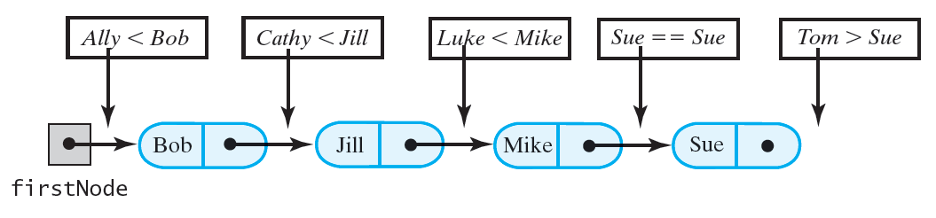
Places to insert names into a sorted chain of linked nodes:
The Method add
Algorithm add(newEntry)
// Adds a new entry to the sorted list.
Allocate a new node containing newEntry
Search the chain until either you find a node containing newEntry or you pass the point where it should be
Let nodeBefore reference the node before the insertion point
if (the chain is empty or the new node belongs at the beginning of the chain)
  Add the new node to the beginning of the chain
else
  Insert the new node after the node referenced by nodeBefore
Increment the length of the sorted list
Notes:
Copyright ©2012 by Pearson Education, Inc. All rights reserved

Slide 9
The Method add – iterative
(chain of nodes)
public void add(T newEntry)
{
Node<T> newNode = new Node(newEntry);
Node<T> nodeBefore = getNodeBefore(newEntry);
if (isEmpty() || (nodeBefore == null))
{
// Add at beginning
newNode.next = this.firstNode;
this.firstNode = newNode;
}
else
{
// Add after nodeBefore
Node<T> nodeAfter = nodeBefore.next;
newNode.next = nodeAfter;
nodeBefore.next = newNode;
}
this.numberOfEntries++;
}
// Finds the node that is before the node that should
// or does contain a given entry.
// Returns either a reference to the node that is
// before the node that contains--or should contain
// anEntry, or null if no prior node exists
// (that is, if anEntry is or belongs at the beginning
// of the list).
private Node<T> getNodeBefore(T anEntry)
{
Node<T> currentNode = this.firstNode;
Node<T> nodeBefore = null;
while ( (currentNode != null) &&
(anEntry.compareTo(currentNode.data) > 0) )
{
nodeBefore = currentNode;
currentNode = currentNode.next;
}
return nodeBefore;
}
Notes:
Copyright ©2012 by Pearson Education, Inc. All rights reserved

Slide 10
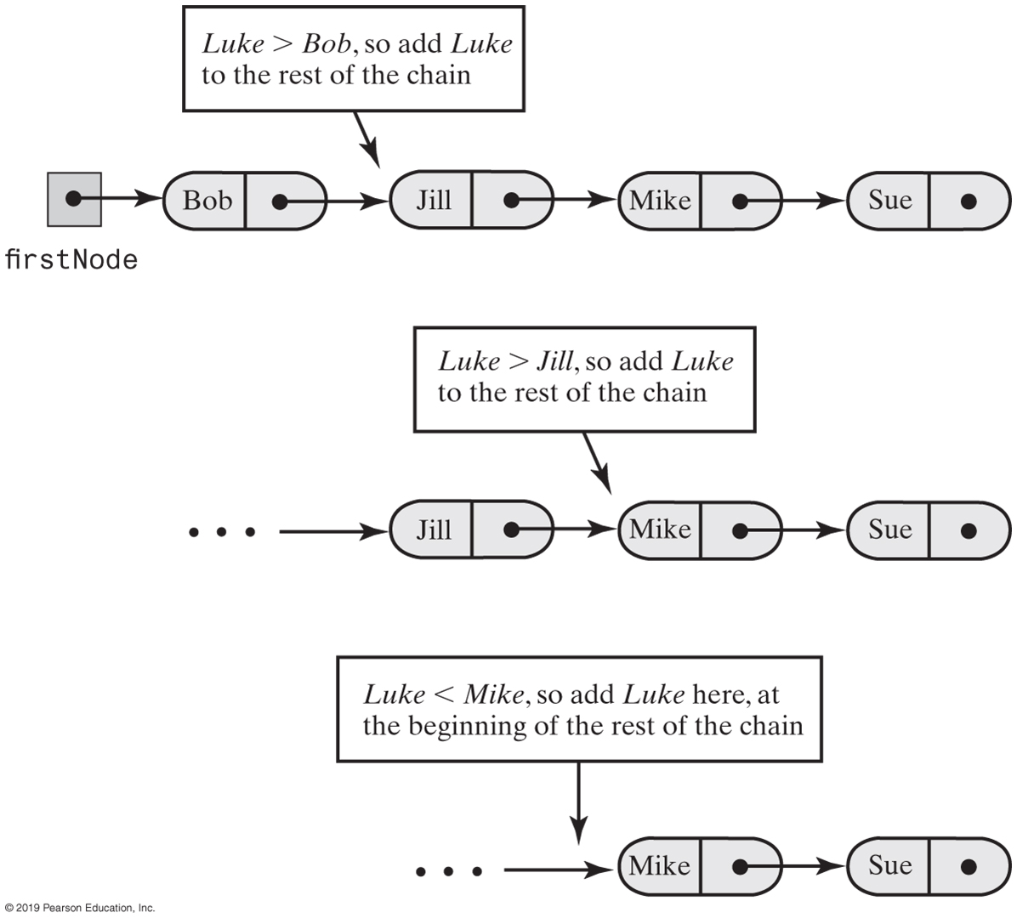
Recursively adding Luke to a sorted chain of names
The Method add - recursive
Notes:
Copyright ©2012 by Pearson Education, Inc. All rights reserved

Slide 11
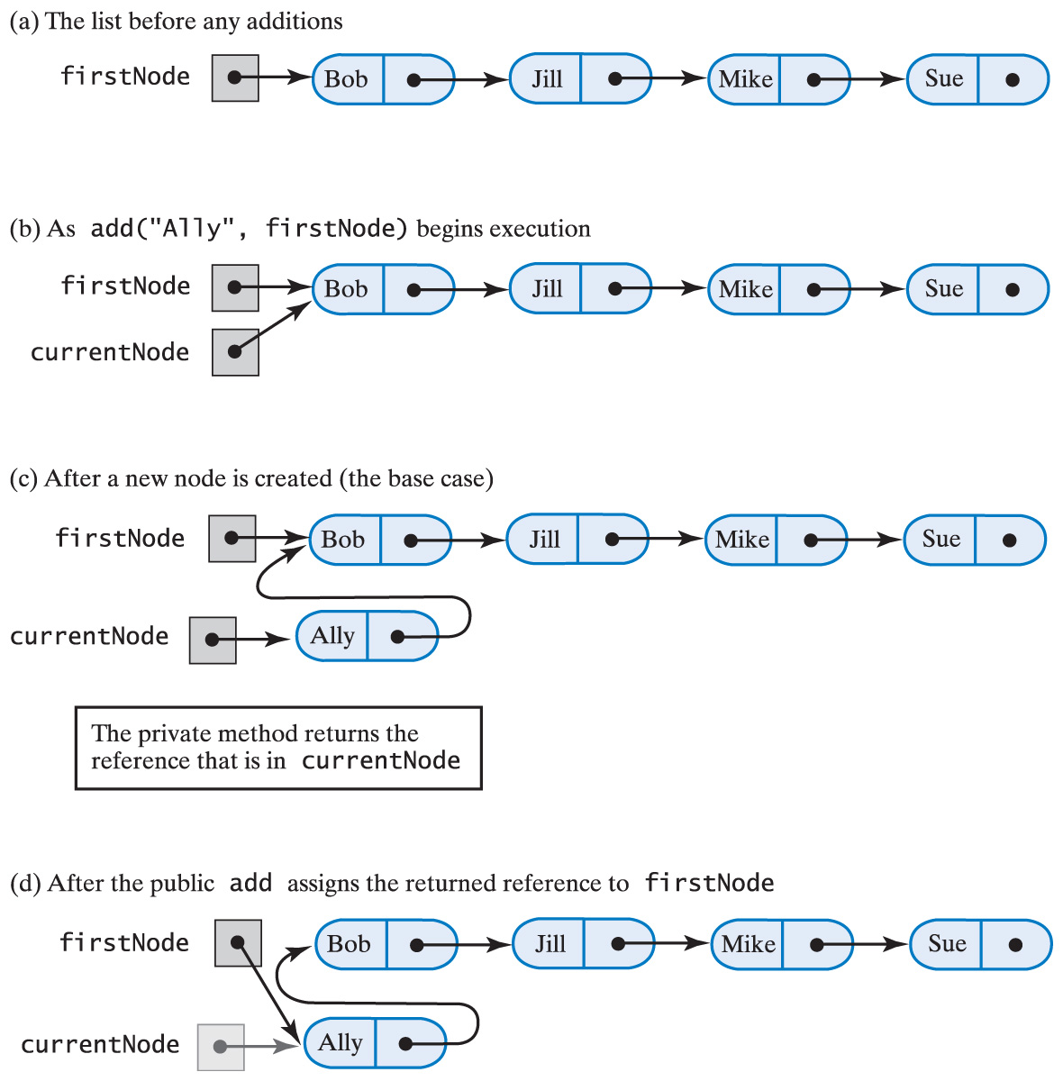
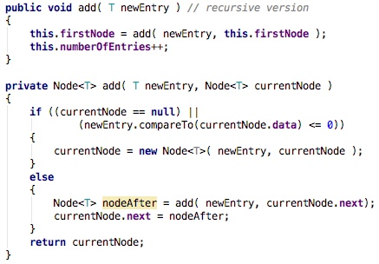
The Method add
Recursively adding a node at the beginning of the chain

Slide 12
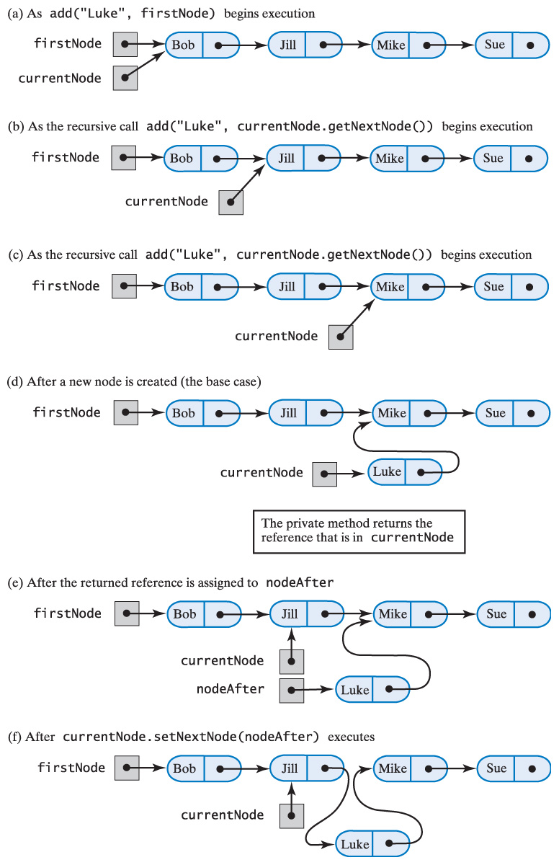
The Method add
Recursively adding a node between existing nodes in a chain

Slide 13
Tracing an addition to sorted list recursively
Given the recursive algorithm below trace execution of the following three scenarios:
  Adding an element to the empty chain
  Adding an element to the following chain:
    add(“Andrew”, firstNode);
    add(“Katy”, firstNode);

Slide 14
The Method add – iterative (with array)
public void add(T newEntry)
{
checkInitialization();
int newEntryPosition = Math.abs(getPosition(newEntry));
// Beginning at the end of the list, shift entries to next higher
// position until proper sorted position for newEntry is reached
int currIndex = this.numberOfEntries;
// Loop is skipped if sorted list is empty or
// insertion is at end of sorted list
while (currIndex >= newEntryPosition)
{
this.list[currIndex + 1] = this.list[currIndex];
currIndex--;
}
this.list[currIndex + 1] = newEntry;
this.numberOfEntries++;
ensureCapacity();
}
public int getPosition(T anEntry)
{
int position = 1;
while ( position <= this.numberOfEntries && !found )
{
int result = anEntry.compareTo(this.list[position]);
if (result > 0)
position++;
else if (result == 0)
found = true;
}
if ( !found )
position = -position;
return position;
}
Notes:
Copyright ©2012 by Pearson Education, Inc. All rights reserved

Slide 15
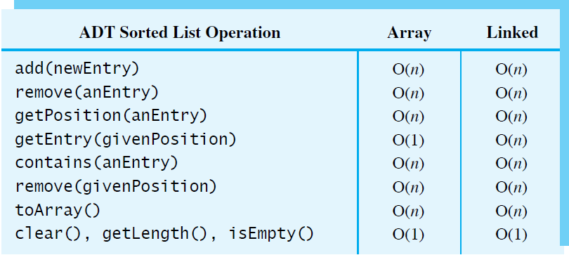
Efficiency of the Sorted List Implementation
The worst-case efficiencies of the operations on the ADT sorted list for two implementations

Slide 16
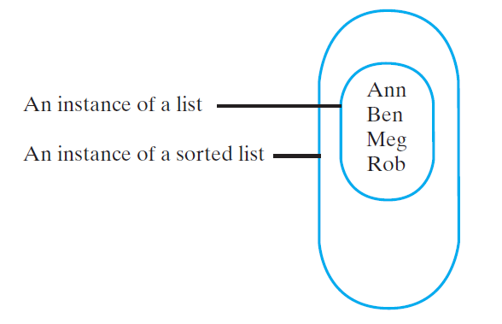
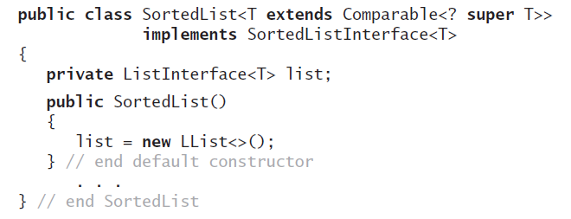
Implementation That Uses the ADT List
Sorted list a natural application for ADT list
Possible ways
  Use list as data field within class that implements sorted list
  Use inheritance to derive sorted list from list
The class SortedList will implement the interface SortedListInterface

Slide 17
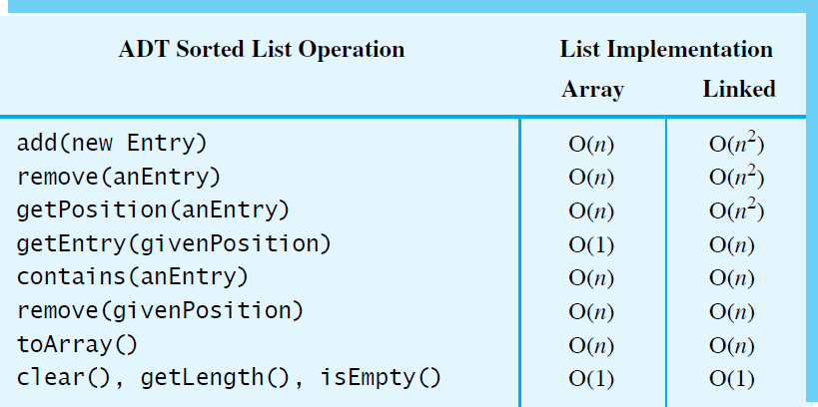
The worst-case efficiencies of the ADT sorted list operations when implemented using an instance of the ADT list
When you use an instance of an ADT list to represent the entries in the ADT sorted list, you must use the list’s operations to access the sorted list’s entries, instead of accessing them directly.
Such an implementation of the sorted list is easy to write but is inefficient when the underlying list uses a chain of linked nodes to store its entries

Slide 18
Java Class Library: java.util.TreeSet
elements in the collection are ordered using their natural ordering,
or by Comparator provided at the collection’s creation time (via proper constructor),
no duplicates are allowed
iterators returned by this class's iterator method are fail-fast:
  if the set is modified at any time after the iterator is created, in any way except through the iterator's own remove method, the iterator will throw a ConcurrentModificationException.
  fail-fast behavior of an iterator cannot be guaranteed as it is impossible to make any hard guarantees in the presence of unsynchronized concurrent modification. Fail-fast iterators throw ConcurrentModificationException on a best-effort basis. Therefore, it would be wrong to write a program that depended on this exception for its correctness: the fail-fast behavior of iterators should be used only to detect bugs.

Slide 19
Searching

Slide 20
Contents
Searching an Unsorted Array
  An Iterative Sequential Search of an Unsorted Array
  A Recursive Sequential Search of an Unsorted Array
  The Efficiency of a Sequential Search of an Array
Searching a Sorted Array
  A Sequential Search of a Sorted Array
  A Binary Search of a Sorted Array
  Java Class Library: The Method binarySearch
  The Efficiency of a Binary Search of an Array
Searching an Unsorted Chain
  An Iterative Sequential Search of an Unsorted Chain
  A Recursive Sequential Search of an Unsorted Chain
  The Efficiency of a Sequential Search of a Chain
Searching a Sorted Chain
  A Sequential Search of a Sorted Chain
  A Binary Search of a Sorted Chain

Slide 21
Objectives
Search an array by using a sequential search
Search an array by using a binary search
Search a chain of linked nodes sequentially
Describe time efficiency of a search

Slide 22
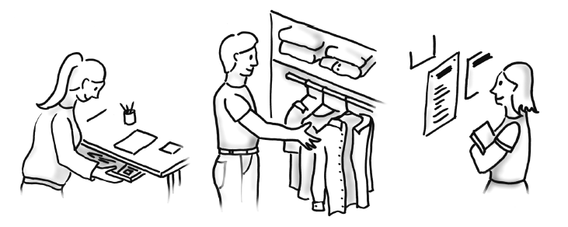
The Problem
Searching is an everyday occurrence

Slide 23
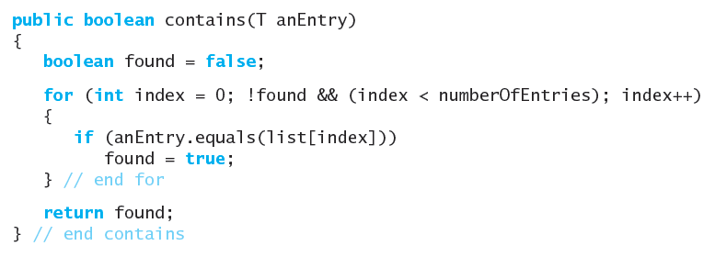
Searching an Unsorted Array
Iterative search, unsorted array

Slide 24
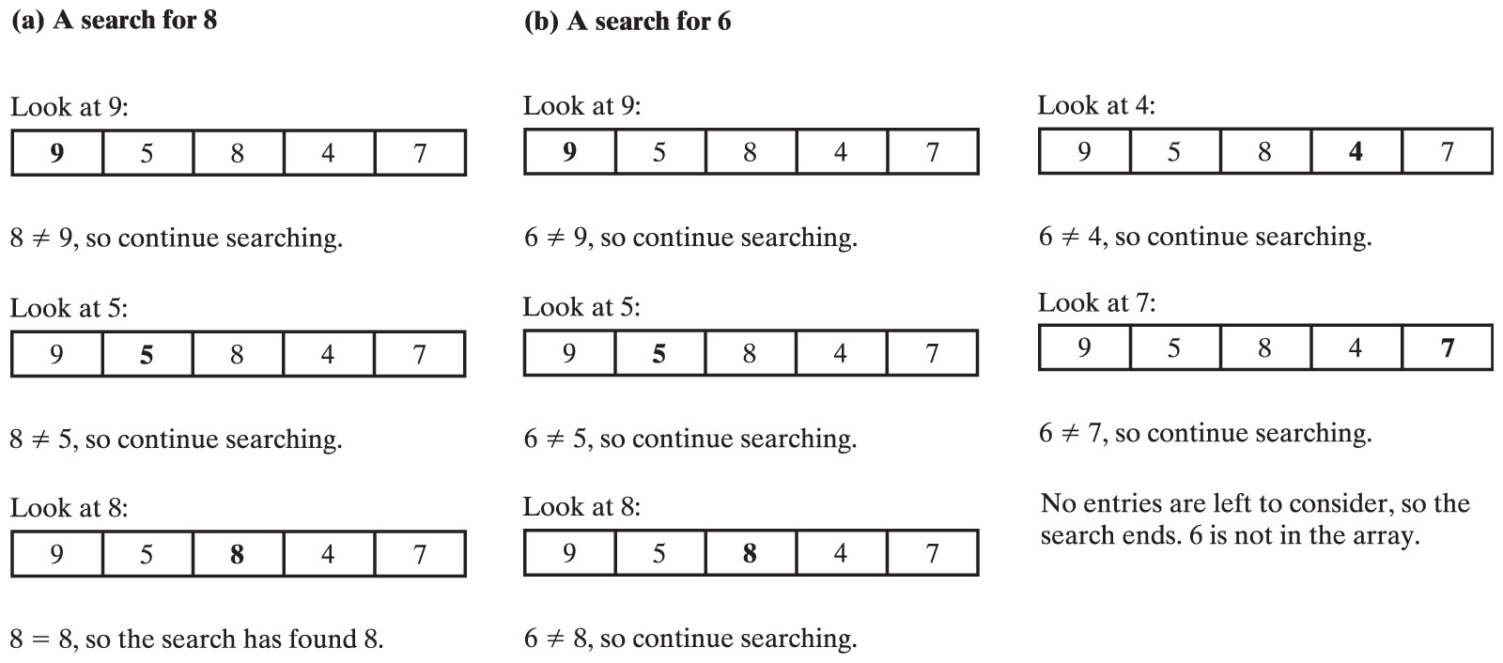
Searching an Unsorted Array
An iterative sequential search of an array that finds its target
An iterative sequential search of an array that does not find its target

Slide 25
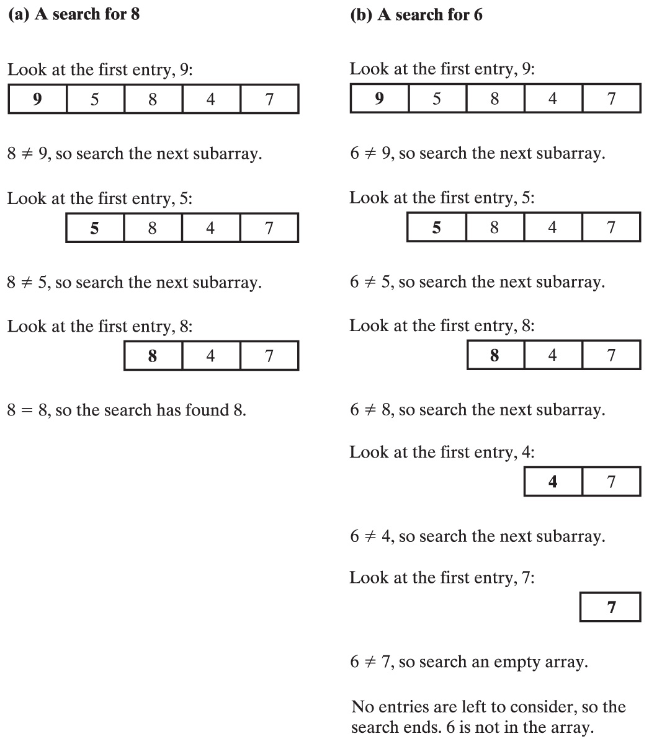
Recursive Sequential Search - Unsorted Array
Algorithm to search a[first] through
a[last] for desiredItem
if (there are no elements to search)
return false
else if (desiredItem equals a[first])
return true
else
return the result of searching a[first+1]
through a[last]

Slide 26
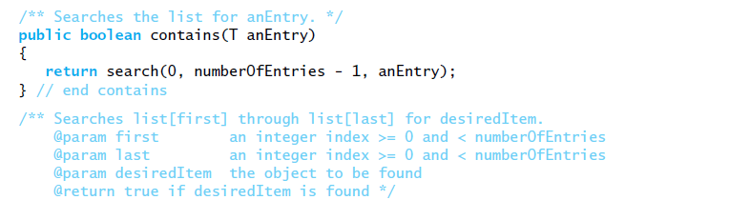
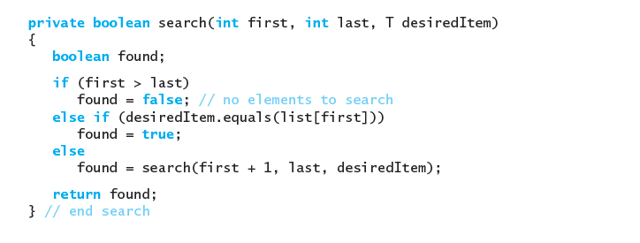
Recursive Sequential Search of an Unsorted Array

Slide 27
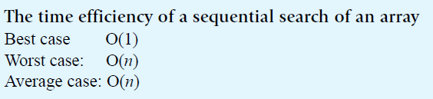
Recursive Sequential Search of an Unsorted Array
Efficiency of a sequential search of an array

Slide 28

Searching a Sorted Array
Coins sorted by their mint dates
A sequential search can be more efficient if the data is sorted
Assuming that list is sorted propose an improvement to the original code:
public boolean contains(T anEntry){
boolean found = false;
boolean larger = true;
for (int index = 0; !found && larger && (index < length); index++)
{
int comparison = anEntry.compareTo(list[index]);
if (comparison == 0)
found = true;
else if (comparison < 0)
larger = false;
} // end for
return found;
} // end contains
public boolean contains (T anEntry)
{
boolean found = false;
for (int index = 0;
!found && (index < length); index++)
{
if (anEntry.equals (list [index]))
found = true ;
} // end for
return found;
} // end contains

Slide 29

Binary Search of a Sorted Array
Ignoring one half of the data when the data is sorted

Slide 30
Sequence of Successful Search - 1
start end mid
search( 44 )
#1
0 8
4
=
+
(end – start)
mid
start
2
0
1
2
3
4
5
6
7
8
5
12
17
23
38
44
77
84
90
start
mid
end
38 < 44
start = mid+1 = 5

Slide 31
Sequence of Successful Search - 2
start end mid
search( 44 )
#1
0 8
4
#2
5 8
6
=
+
(end – start)
mid
start
2
0
1
2
3
4
5
6
7
8
5
12
17
23
38
44
77
84
90
start
mid
end
end = mid-1=5
44 < 77

Slide 32
Sequence of Successful Search - 3
start end mid
search( 44 )
#1
0 8
4
#2
5 8
6
#3
5 5
5
(end – start)
mid
=
start
+
2
0
1
2
3
4
5
6
7
8
5
12
17
23
38
44
77
84
90
start
end
mid
Successful Search!!
44 == 44

Slide 33
Sequence of Unsuccessful Search - 1
start end mid
search( 45 )
#1
0 8
4
=
+
(end – start)
mid
start
2
0
1
2
3
4
5
6
7
8
5
12
17
23
38
44
77
84
90
start
mid
end
38 < 45
start = mid+1 = 5

Slide 34
Sequence of Unsuccessful Search - 2
start end mid
search( 45 )
#1
0 8
4
#2
5 8
6
=
+
(end – start)
mid
start
2
0
1
2
3
4
5
6
7
8
5
12
17
23
38
44
77
84
90
start
mid
end
end = mid-1=5
45 < 77

Slide 35
Sequence of Unsuccessful Search - 3
start end mid
search( 45 )
#1
0 8
4
#2
5 8
6
#3
5 5
5
(end – start)
mid
=
start
+
2
0
1
2
3
4
5
6
7
8
5
12
17
23
38
44
77
84
90
start
end
mid
44 < 45
start = mid+1 = 6

Slide 36
Sequence of Unsuccessful Search - 4
start end mid
search( 45 )
#1
0 8
4
#2
5 8
6
#3
5 5
5
=
+
(end – start)
#4
6 5
mid
start
2
0
1
2
3
4
5
6
7
8
5
12
17
23
38
44
77
84
90
end
start
Unsuccessful Search
no more elements to search
start > end

Slide 37
Binary Search of a Sorted Array
Algorithm for binary search
Algorithm binarySearch (a, first, last, desiredItem)
mid = first + (last - first) / 2 // approximate midpoint
if (first > last)
return false
else if (desiredItem equals a [mid])
return true
else if (desiredItem < a [mid])
return binarySearch (a, first, mid - 1, desiredItem)
else // desiredItem > a[mid]
return binarySearch (a, mid + 1, last, desiredItem)

Slide 38
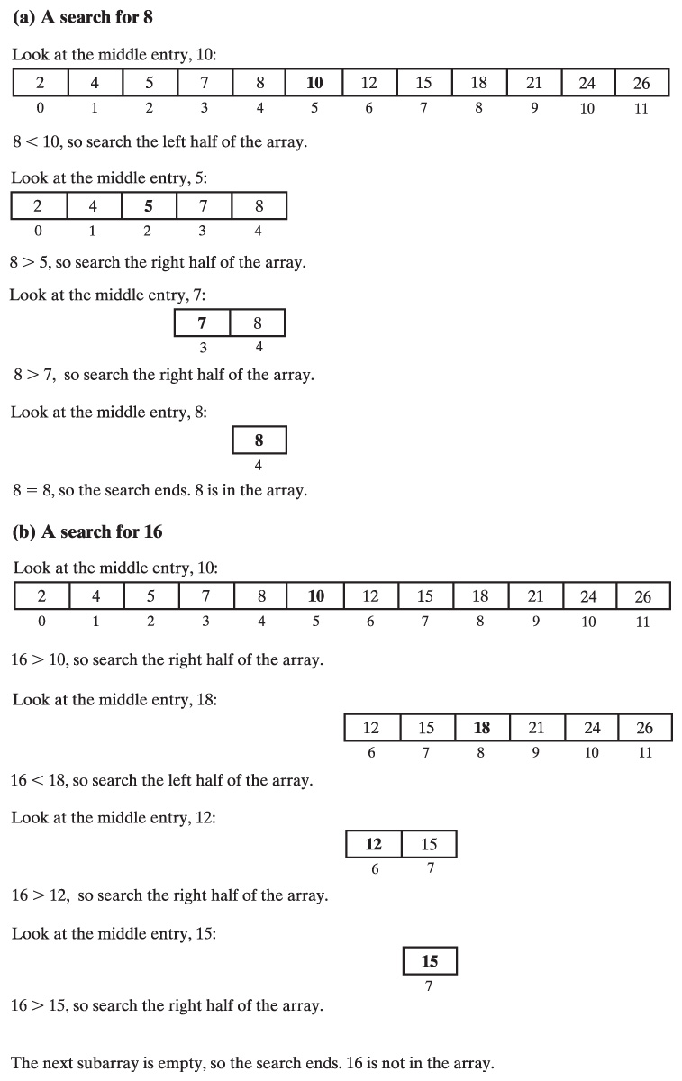
Binary Search of Sorted Array
A recursive binary search of a sorted array that (a) finds its target
Algorithm binarySearch (a, first, last, desiredItem)
mid = first + (last - first) / 2 // approximate midpoint
if (first > last)
return false
else if (desiredItem equals a [mid])
return true
else if (desiredItem < a [mid])
return binarySearch (a, first, mid - 1, desiredItem)
else // desiredItem > a[mid]
return binarySearch (a, mid + 1, last, desiredItem)

Slide 39
Binary Search of Sorted Array
A recursive binary search of a sorted array that (b) does not find its target
Algorithm binarySearch (a, first, last, desiredItem)
mid = first + (last - first) / 2 // midpoint
if (first > last)
return false
else if (desiredItem equals a [mid])
return true
else if (desiredItem < a [mid])
return binarySearch (a, first, mid - 1, desiredItem)
else // desiredItem > a[mid]
return binarySearch (a, mid + 1, last, desiredItem)

Slide 40
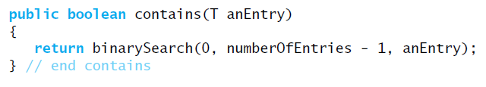
Binary Search of a Sorted Array
Implementation of a sorted list
Method contains that will call binarySearch

Slide 41
Compare recursive search: sequential with binary – ex1
Search the previous array for 8 and for 16 by using a recursive sequential search. In each case which algorithm requires fewer comparisons?
    2₀ 4₁ 5₂ 7₃ 8₄ 10₅ 12₆ 15₇ 18₈ 21₉ 24₁₀ 26₁₁
Searching for 8:
  Binary search: 4 comparisons
  Sequential search: 5 comparisons
Searching for 16:
  Binary search: 4 comparisons
  Sequential search: 9 comparisons
Binary search requires fewer comparisons in each case

Slide 42
Binary Search – ex 2
During a binary search, which elements in the array:
4₀ 8₁ 12₂ 14₃ 20₄ 24₅
are compared to the target when the target is:
  2
  12
  4
  8
  12
  4
  8
  15
  12
  20
  14

Slide 43
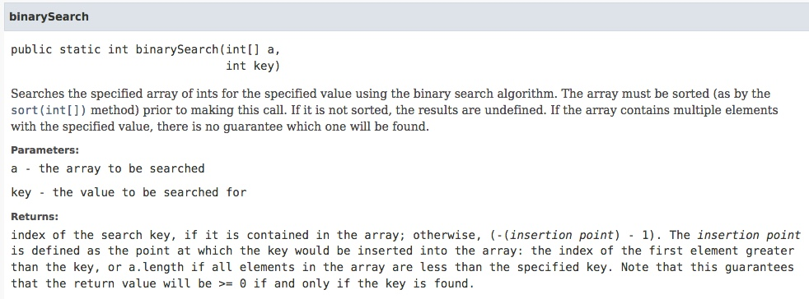
Java Class Library:
The Method binarySearch
Class Arrays contains versions of static method
  Note specification

Slide 44
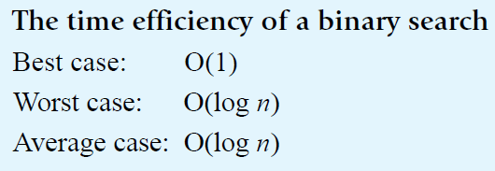
Efficiency of a Binary Search of an Array
Given n elements to be searched
Number of recursive calls is of order
log₂ n

Slide 45
Binary Search – ex3
Think of a number between 1 and 1,000,000. When I guess at your number, tell me whether my guess is correct, too high, or too low. At most, how many attempts will I need before I guess correctly?
  log₂1000000 ~ 20

Slide 46

Iterative Sequential Search of an Unsorted Chain
public boolean contains(T anEntry)
{
Node<T> currentNode = this.firstNode;
boolean found = false;
while ( !found && (currentNode != null))
{
if (anEntry.equals(currentNode.data)
found = true;
else
currentNode = currentNode.next;
}
return found;
}

Slide 47
Recursive Sequential Search of an Unsorted Chain
Method search
private boolean search(Node<T> currentNode, T desiredItem)
{
boolean found;
if ( currentNode == null )
found = false;
else if ( desiredItem.equals(currentNode.data) )
found = true;
else
found = search( currentNode.next, desiredItem );
return found;
}

Slide 48
Recursive Sequential Search of an Unsorted Chain
Public method contains
  Calls method search
public boolean contains(T desiredItem)
{
return search( this.firstNode, desiredItem );
}

Slide 49
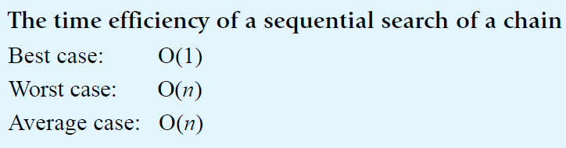
Efficiency of a Sequential Search of a Chain

Slide 50
Sequential Search of a Sorted Chain
Similar to sequentially searching a sorted array
public boolean contains(T anEntry)
{
Node<T> currentNode = this.firstNode;
while ((currentNode != null) &&
(anEntry.compareTo(currentNode.data > 0))
{
currentNode = currentNode.next;
}
return (currentNode != null) &&
(anEntry.equals(currentNode.data);
}

Slide 51
Binary Search of a Sorted Chain
Binary search of a chain of linked nodes is impractical
  Why?
  Recall finding middle element in an array is easy:
        mid = first + (last - first) / 2
  Finding middle element of sorted chain more difficult
    To find the middle of the chain you must traverse the whole chain
    Then must traverse one of the halves to find the middle of that half
Conclusion
  Hard to implement
  Less efficient than sequential search

Slide 52
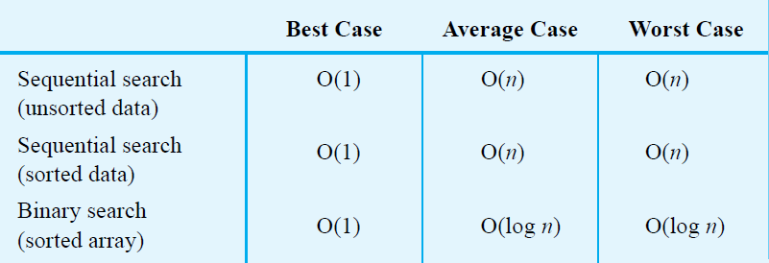
Choosing between Sequential Search and Binary Search
Sequential search
  Suitable for smaller array
  Objects must have appropriate equals method
Binary search
  Suitable for larger collections
  Objects must have appropriate compareTo method
In both cases ask, “Search how often?”

Slide 53
Choosing between Iterative Search and Recursive Search
Can save some time and space by using iterative version of a search
Using recursion will not require much additional space for the recursive calls
Coding binary search recursively is somewhat easier

Slide 54
Interview Question
https://www.youtube.com/watch?v=XKu_SEDAykw

